Slide 1


Department of Information Engineering
Advanced Networking
Network Automation and Deployment
Mulat Tiruye
ID: 684343

Slide 2

Introduction
Automates network, deployment and configuration.
Uses YAML for data definition and Jinja2 for configuration generation.
Leverages Containerlab for network topology deployment.
Features multiple routers across autonomous systems (AS) with BGP as the primary protocol.
BGP monitoring data collection.

Slide 3
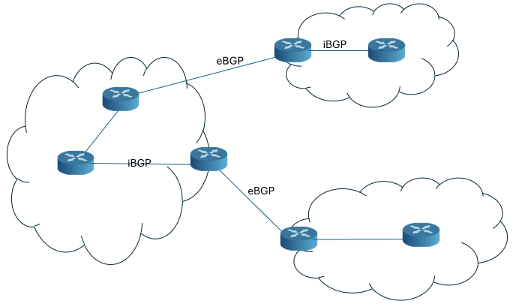
Border Gateway Protocol (BGP)
Protocol for exchanging routing information between networks.
Connects autonomous systems (AS) to form the internet.
Determines the best path based on policies, not distance.
Operates in two modes: iBGP (internal) and eBGP (external).

Slide 4
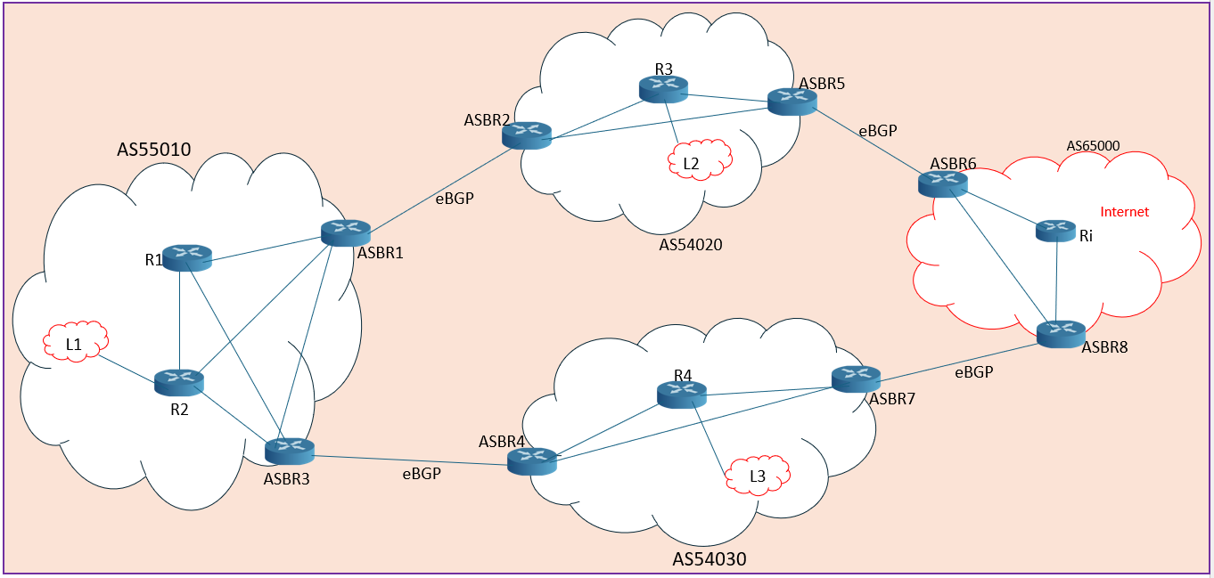
ASBR acts as the BGP speaker for external communication between different ASes.
Full mesh iBGP for internal
eBGP for external

Slide 5
Task 1 – Network Automation System
Device Provisioning:
Automates creation of startup-config files using YAML and Jinja2.
YAML:
Human-readable and structured
Defining network parameters IP addresses, AS numbers, and BGP neighbors
Jinjia2:
Dynamic template generation
Creation of reusable and modular configuration templates
Reduces manual effort and ensures consistency across routers.

Slide 6
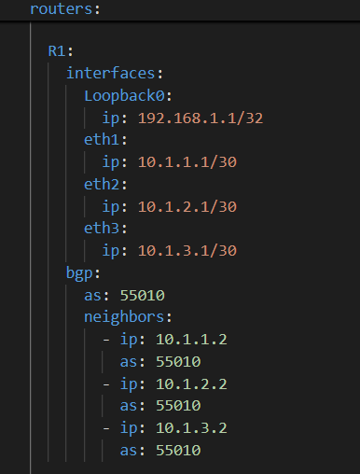
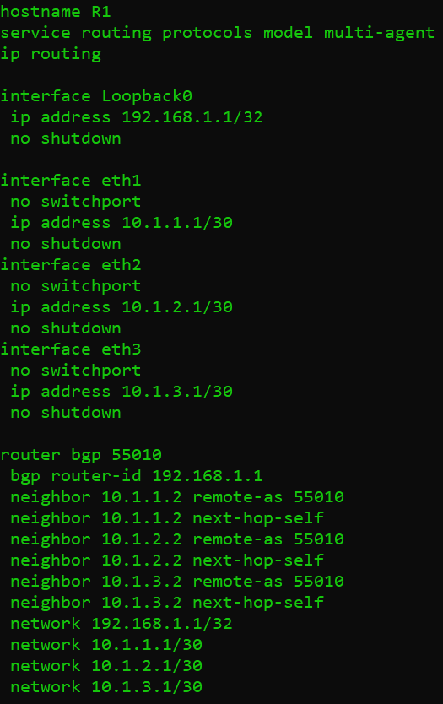

Slide 7
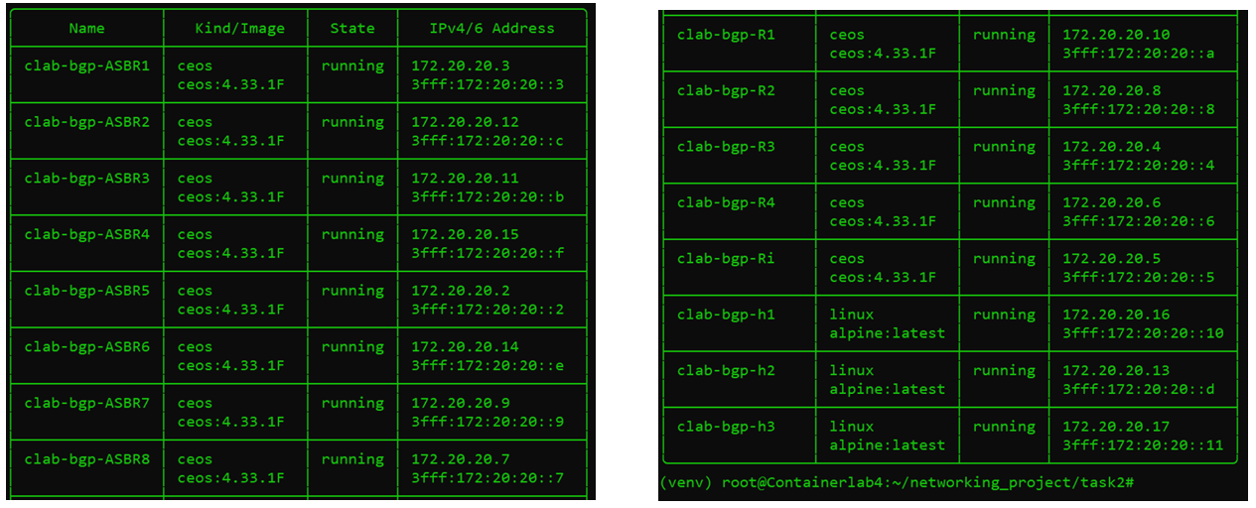
Task 2 – Network Deployment
Internal Routers: R1, R2, R3, R4 handle intra-AS routing.
AS Border Routers (ASBRs): ASBR1–ASBR8 peer with external ASes.
Hosts: h1, h2, h3 for testing and validation of local
network.

Slide 8
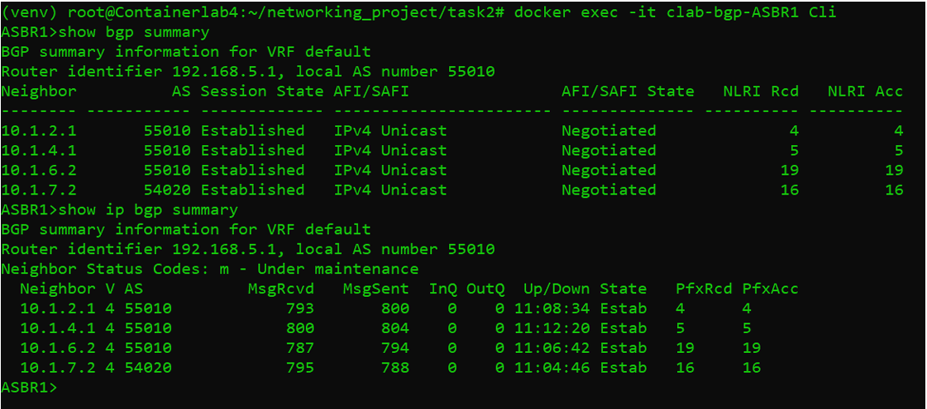
ASBR Peering Negotiation
Internal Peering: Established with neighbors 10.1.2.1, 10.1.4.1, 10.1.6.2.
External Peering: Established with neighbor 10.1.7.2 (AS54020).
Stable Sessions: All BGP sessions show healthy uptime and no queued messages.
Address Family Identifier/SAFI

Slide 9
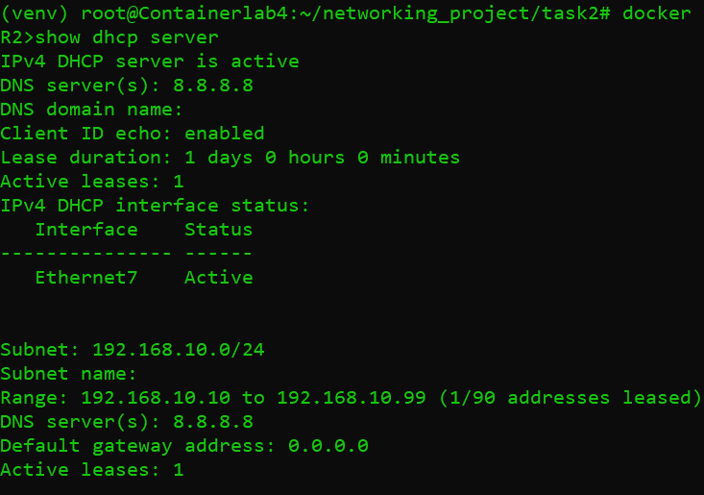
DHCP Configuration
IPv4 DHCP Server:
Active on interface Ethernet7 with subnet 192.168.10.0/24.
Address range: 192.168.10.10 to
192.168.10.99
DNS :
DNS server: 8.8.8.8.
Lease Duration:
Lease duration: 1 day.

Slide 10
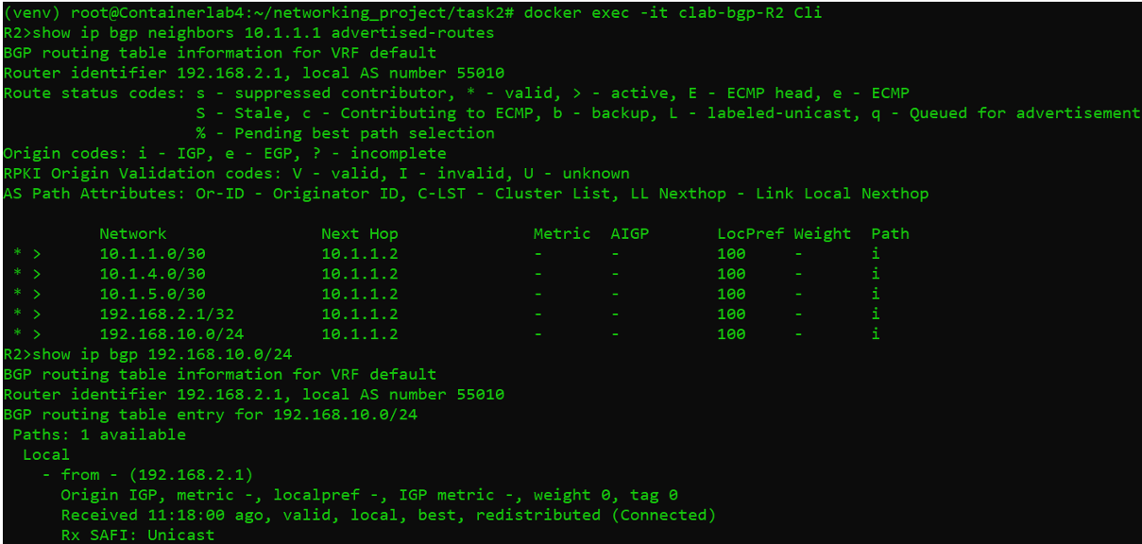
BGP Announcement for Local Host
Local Network Announcement:
All local networks are correctly announced through BGP.
DHCP Advertisement:
The DHCP server network (192.168.10.0/24) is advertised

Slide 11
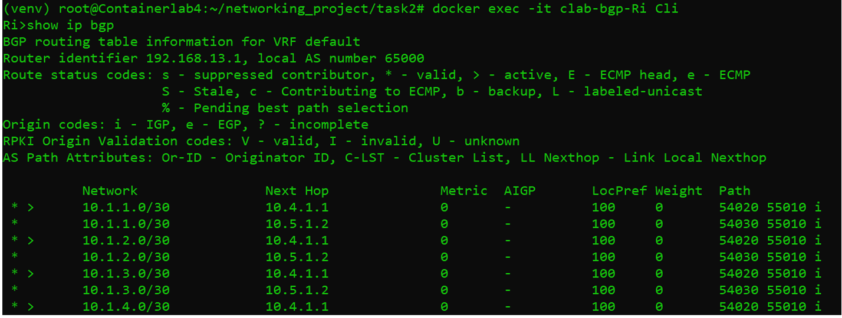
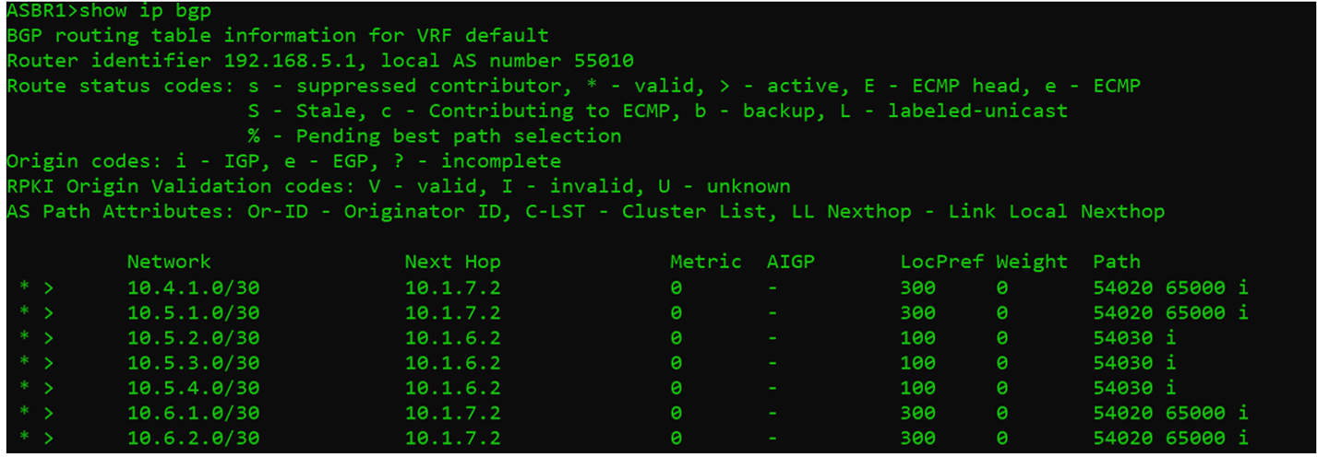
Transit and Preference Configuration
Transit Configuration:
AS54020 and AS54030 act as transit for AS55010.
Verified AS paths (54020 55010 i and 54030 55010 i).
Preference Configuration:
Routes from AS54020 have a local preference of 300 (preferred) to Internet.
Traffic routed optimally through AS54020.

Slide 12
Task 3 – BGP Monitoring System
Used Arista eAPI, JSONRPC(JSON Remote Procedure Call) for automated retrieval of BGP data.
JSON files generated for each router (e.g., ASBR1_bgp_monitor.json).
Includes nextHop, localPreference, and routeType (active/valid).
Monitors all routers (ASBR1–ASBR8, R1–R4).

Slide 13
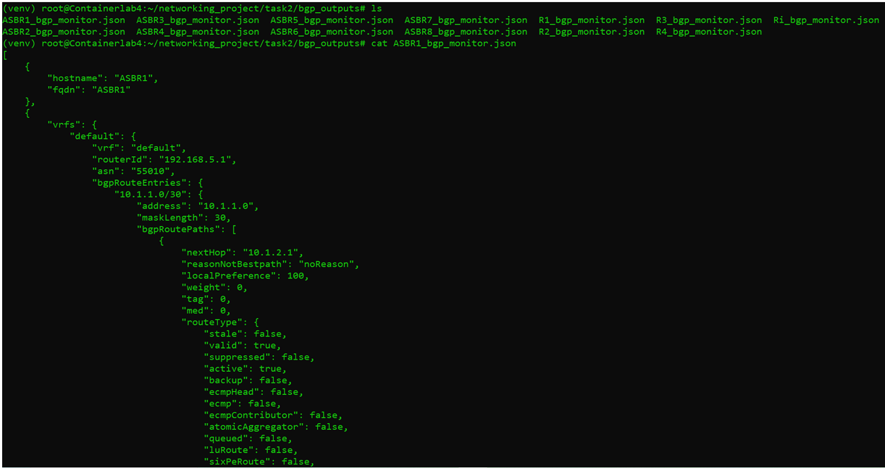

Slide 14
Conclusion
Automated device provisioning using Jinja2 and Python.
Deployed a fully functional multi-AS network with BGP configurations.
Implemented a BGP monitoring system using Arista eAPI.

Slide 15
Thank You for Listening!

